Slide 1
Continuous Random Variable
A continuous random variable is such that any value (to any number of decimal places) within some interval is a possible value.
Heights of individuals
Time to finish a test
Hours spent exercising last week

Slide 2
Natural: human height, temperature, blood pressure
Man Made: machined products
For these measure, the average tends to be more frequent while values away from the mean are less frequent

Slide 3
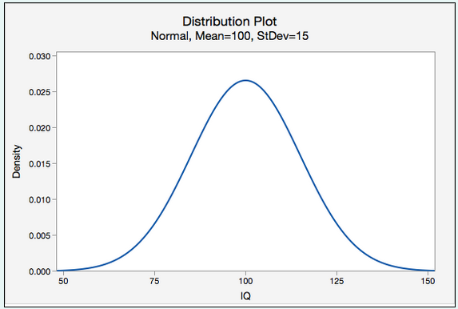
Normal Random Variables
A symmetric bell-shaped density function.
The distribution of IQ scores is normal
The total area under the curve is 1.00, or 100%.
In other words, 100% of observations fall under the curve.

Slide 4
The normal distribution has the following properties:
The distribution is symmetric, so its measure of skewness is zero
The mean, median, and mode are all equal. Half area falls above mean and half below
The range of X is unbounded. Meaning the tail extend to positive and negative infinity
The empirical rule apply exactly for normal distribution. The empirical rule tells you what percentage of your data falls within a certain number of standard deviations from the mean:
68% of the data falls within one standard deviation of the mean.
95% of the data falls within two standard deviations of the mean.
99.7% of the data falls within three standard deviations of the mean.
Standard normal distribution is a special case of normal distribution where mean = 0 and S.D = 1

Slide 5
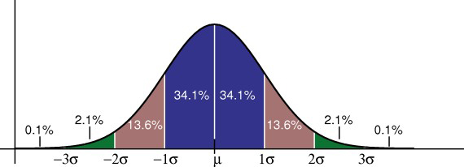

Steps to solve a normal distribution problem:
Draw a bell shaped curve with a mean line. Shade the area or probability we are looking for by looking at the keywords – Between, Less than, greater than etc.
Find out the Z score –
subtract the mean from X
divide by the standard deviation.
Find corresponding probability from the Z table

Slide 6
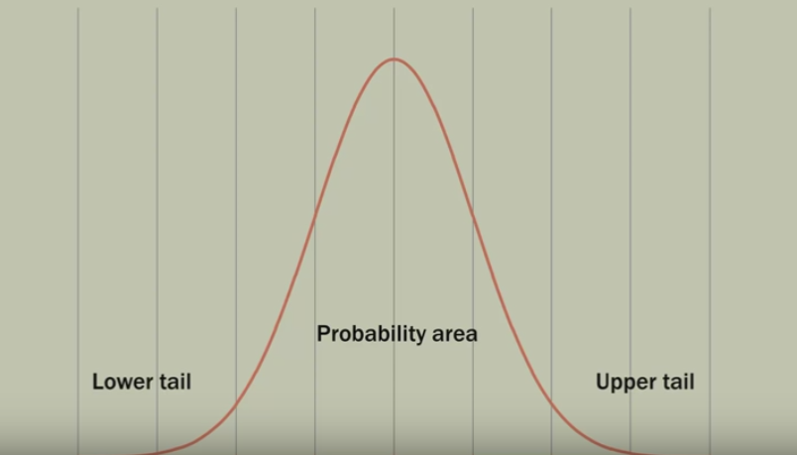

Slide 7
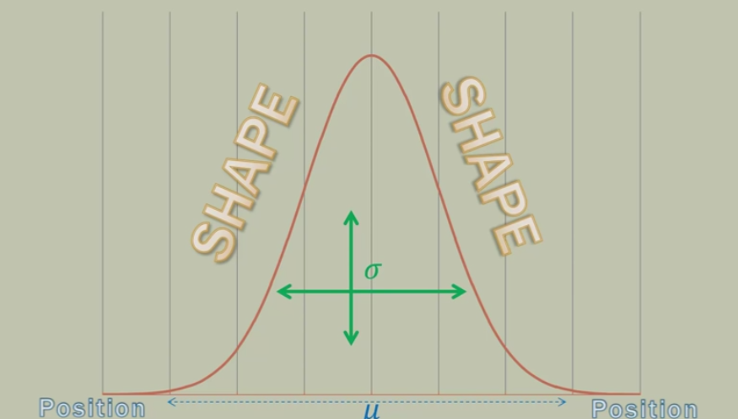

Slide 8
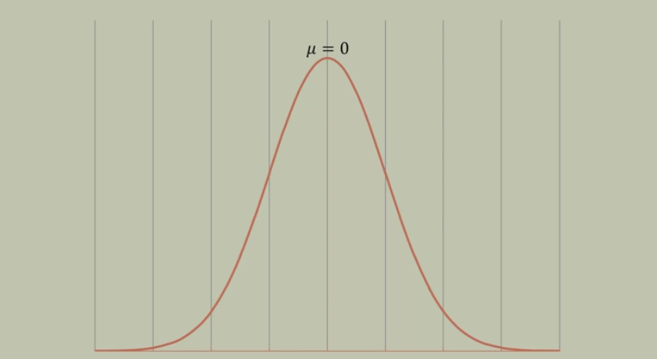
µ can be any numerical value
Slides distribution side to side

Slide 9
This becomes very very important when you are trying to determine the two population/sample are statistically different or not.

Slide 10
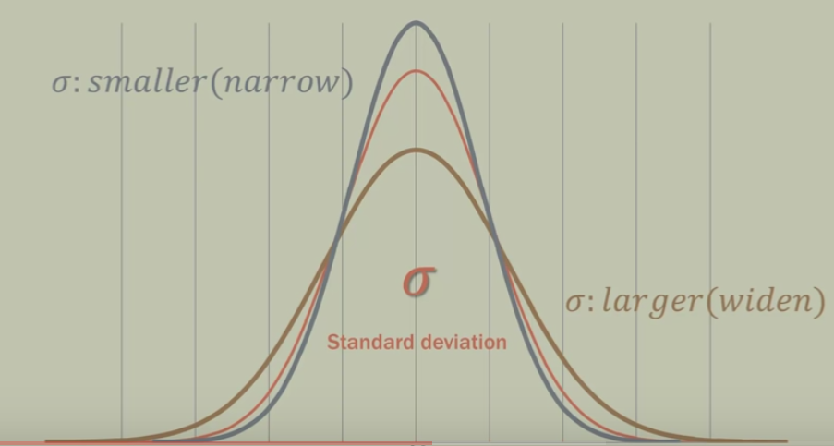

Slide 11
probability that the IQ of a randomly selected individual will be less than 115

Slide 12
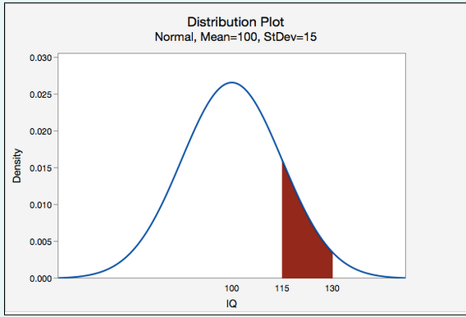
probability that the IQ of a randomly selected individual will be between 115 and 130

Slide 13
Scenario: Vehicle speeds at a highway location have a normal distribution with a mean of 65 mph and a standard deviation of 5 mph.
Question: What is the probability that a randomly selected vehicle will be going 73 mph or slower?

Slide 14
probability that a randomly selected vehicle speed is greater than 73

Slide 15
Suppose pulse rates of adult females have a normal curve distribution with mean of 75 and a standard deviation of 8. What is the probability that a randomly selected female has a pulse rate greater than 85?

Slide 16
The lifetime of a battery is normally distributed with a mean life of 40 hours and a standard deviation of 1.2 hours. Find the probability that a randomly selected battery lasts longer than 42 hours.

Slide 17

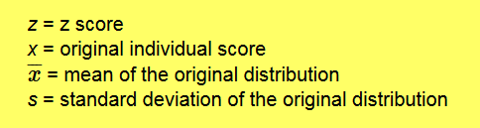
Standard Normal distribution

Slide 18
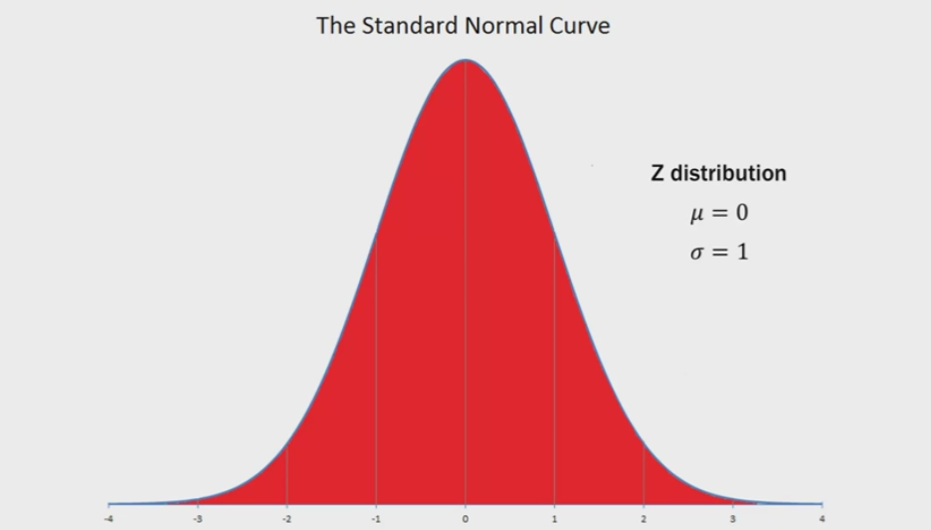

Slide 19
Area under the curve is 1

Slide 20
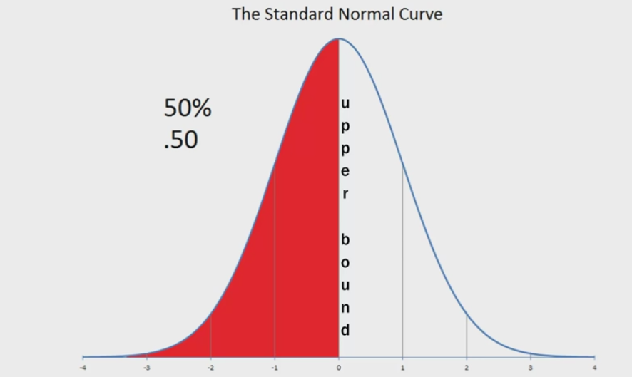

Slide 21
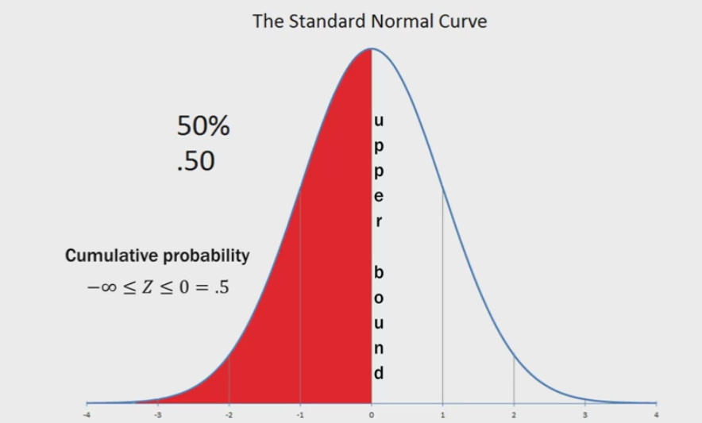

Slide 22
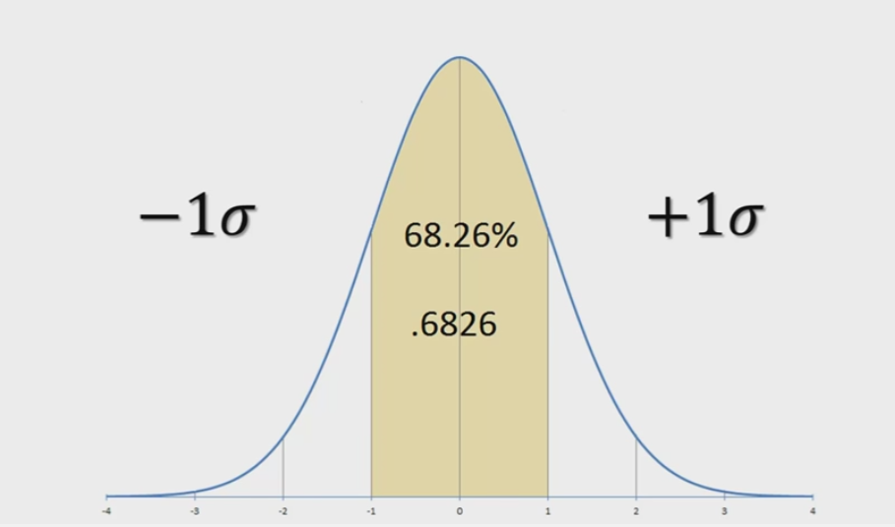

Slide 23
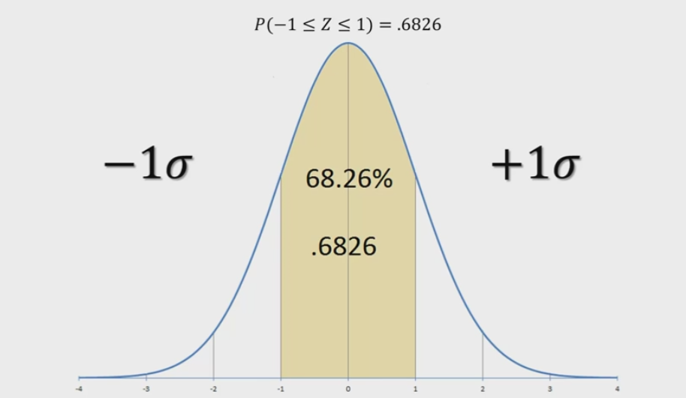

Slide 24
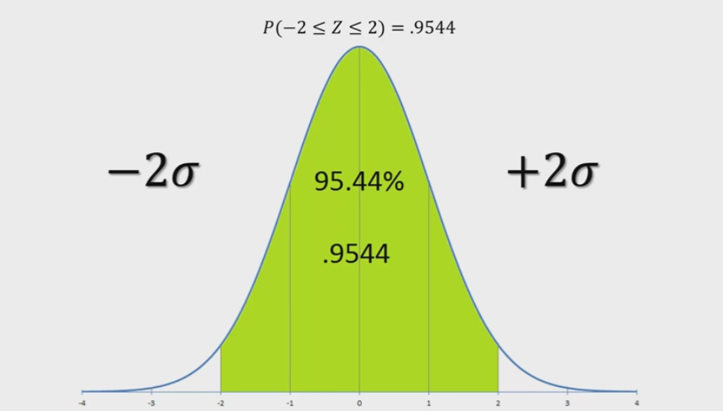

Slide 25
In statistics we use 95% confidence interval that is exactly -1.96 to +1.96.

Slide 26
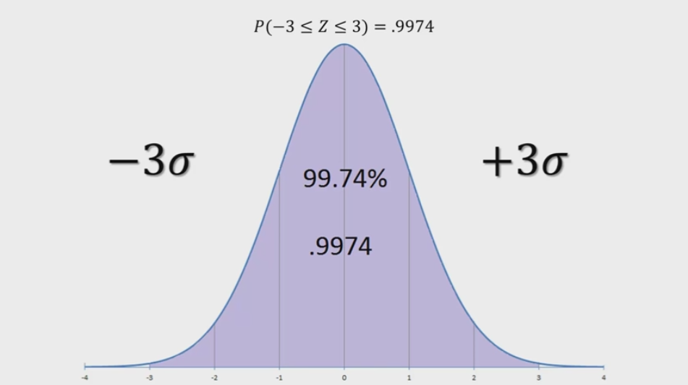

Slide 27
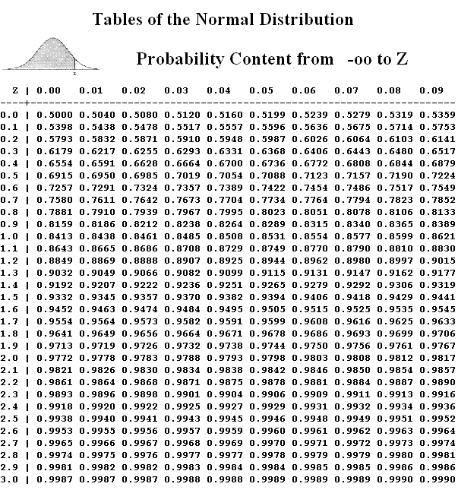

Slide 28
Consider taking two random samples, each sample consisting of 5 students,
from a class and calculating the mean height in each sample. Would you expect both sample means to be exactly the same?

Slide 29
No, the two sample means would be different because of random sampling error.
If you were to repeatedly pull samples of 5 students from the population of all students and compute the mean of each sample, you could construct a distribution of sample means.

Slide 30
Sampling Distribution
The distribution of the values of sample statistic computed for each possible sample drawn from target population.

Slide 31
Sampling Distribution
The distribution of the values of sample statistic computed for each possible sample drawn from target population.

Slide 32
Sampling Distribution
The distribution of the values of sample statistic computed for each possible sample drawn from target population.
It is used estimate the population parameter

Slide 33
Statistics
Mean of mean of sampling distribution
Standard deviation of mean of sampling distribution

Slide 34
Central Limit Theorem
With a sample size of at least 30, the distribution of sample means will be approximately normally distributed regardless of the shape of the population with a mean of μ and a standard deviation of sigma/root(n). This is known as the Central Limit Theorem.

Slide 35
In the population, IQ scores are normally distributed with a mean of 100 and standard deviation of 15. If we repeatedly pulled random samples of 25 individuals from the population and measured their IQ, what proportion of those samples would we expect to have a sample mean between 95 and 105?

Slide 36
The height of women in the United States is normally distributed with a mean of 163cm and standard deviation of 6cm. What is the probability that you would randomly select one woman in the United States and she is taller than 169cm?
The height of women in the United States is normally distributed with a mean of 163cm and standard deviation of 6cm. What is the probability that you would randomly select a sample of n=50 women in the United States and their average height is greater than 169cm?

Slide 37
According to one source, newborn baby weights have a mean of 7.5 pounds with a standard deviation of 1.1 pounds.
If these numbers are accurate, what proportion of samples of n=50 would have a sample mean greater than 8 pounds?

Slide 38
In Article published, the population of all World Campus students 49.2% were female.
Wanted to check whether it is actually true.
He obtains a random sample of 50 students. In his random sample there were 28 females and 22 males.
If the population from which her sample was drawn really is 49.2% female, what is the probability that she would take a random sample of 50 students and find that 28 or more are females?

